Slide 1
Intuilize – Cluster Commanders Customer Segmentation & Prediction Weekly Meeting 2/14/2025
Andy, Graham, Keertana, & Shashank

Slide 2
Agenda
Model Selection
Correlation Analysis

Slide 3
Model Selection
Researching various models
Found a couple models that might work well

Slide 4
Fuzzy Clustering (Fuzzy C-Means)
Assigns data points a score for association with each cluster.
Will be easily applied to prediction model as well.
Markov Chain

Slide 5
Hierarchal Models
Iteratively splits or merges clusters until either one cluster, or every data point is its own cluster.
Handles non spherical clusters better.

Slide 6
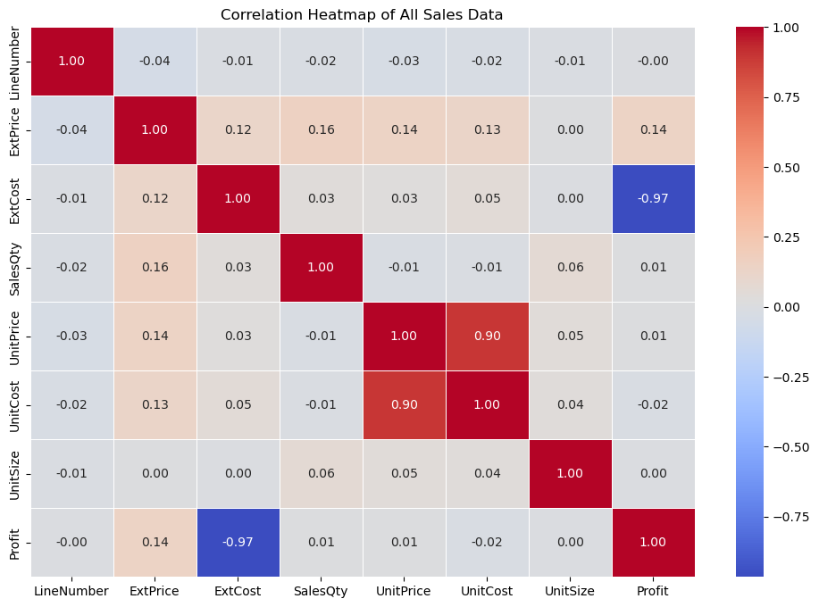
Correlation Analysis

Slide 7
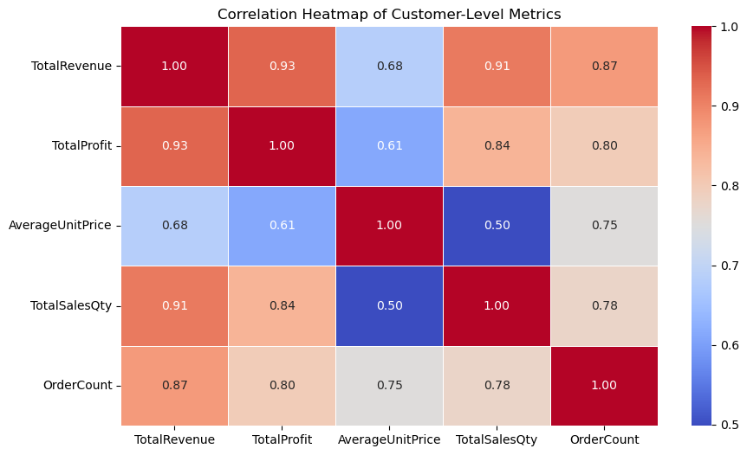
Correlation Analysis

Slide 8
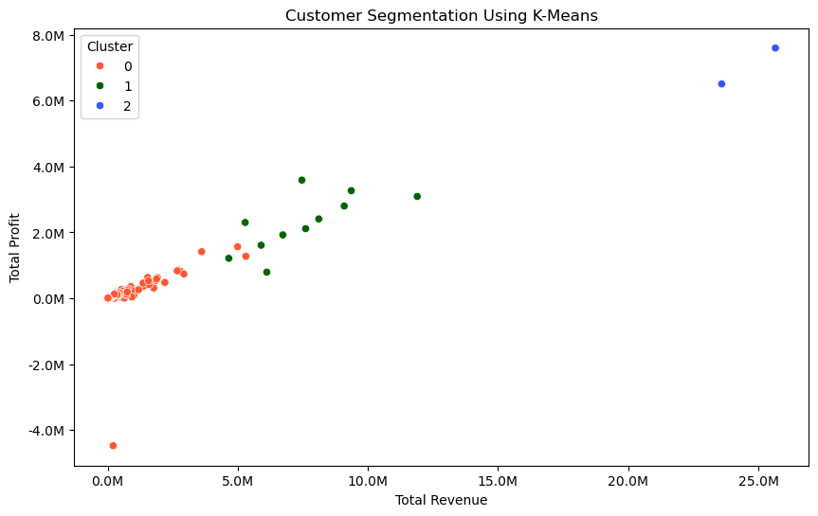
Initial model testing (testing K-Means)

Slide 9
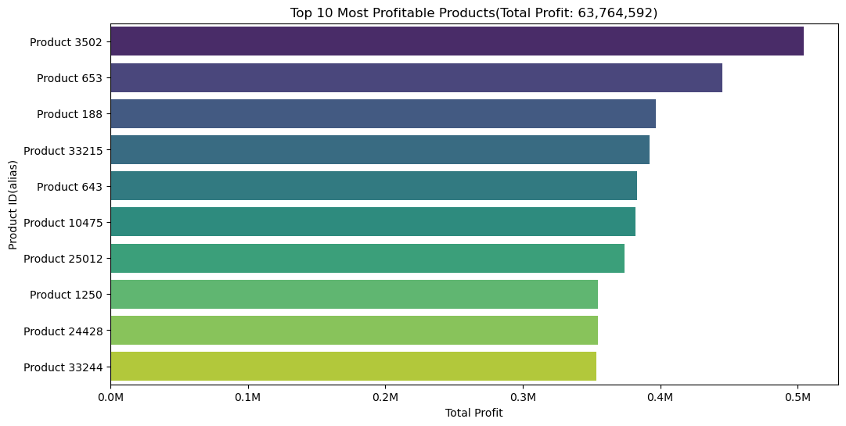
Product profits

Slide 10
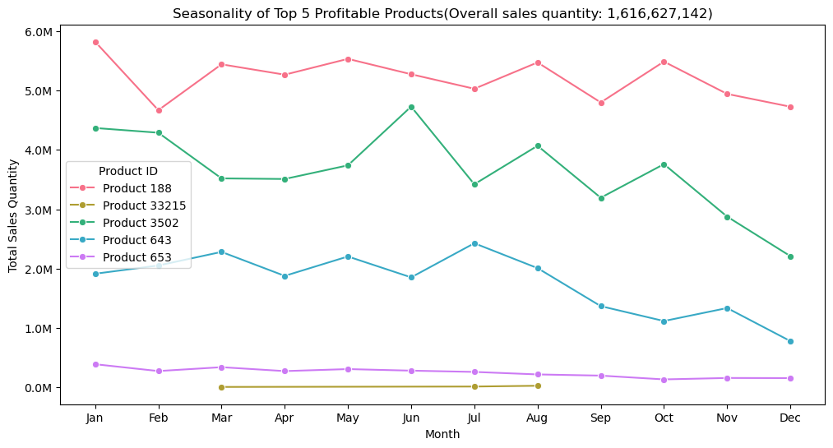
Testing Monthly Trends

Slide 11

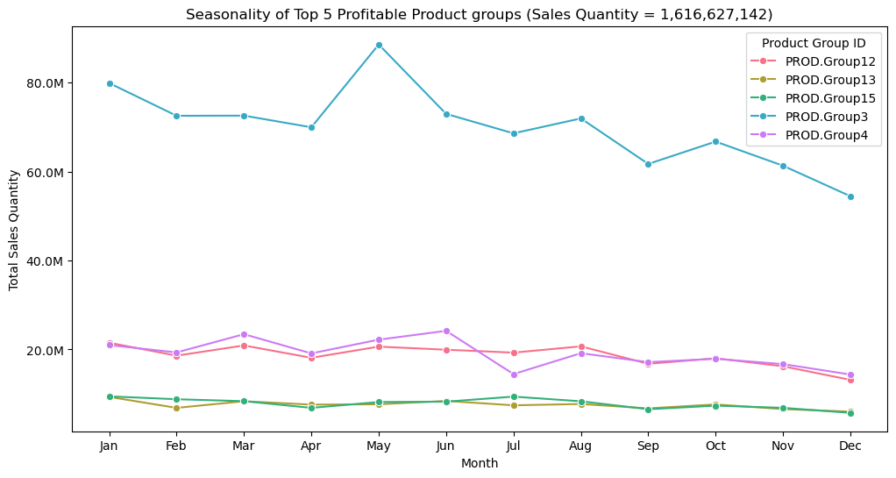



Product Group Monthly Trends

Slide 12
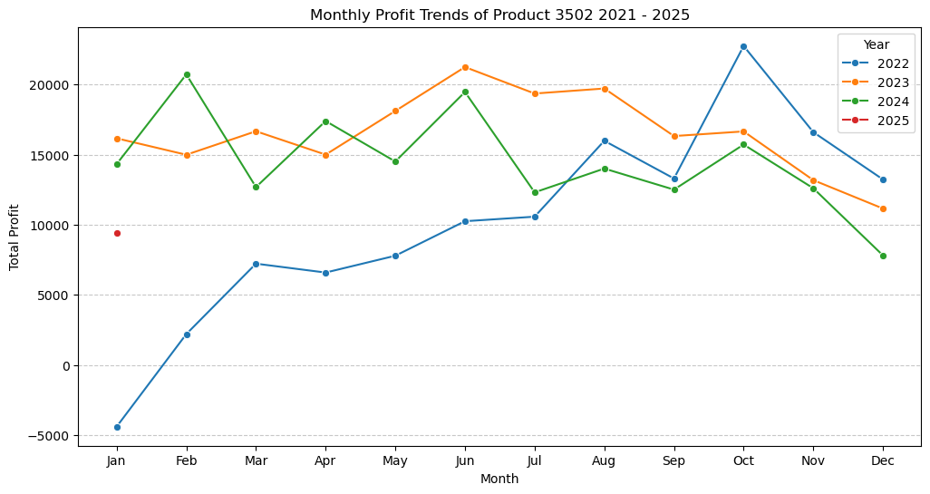
Top Product monthly Trends

Slide 13
THANK YOU!

